Slide 1
SUPPORTING DOCUMENT FOR 7.3.1
Portray the performance of the institution in one area distinctive to its priority and thrust within 1000 words.
.
INSTITUTIONAL DISTINCTIVENESS

Slide 2
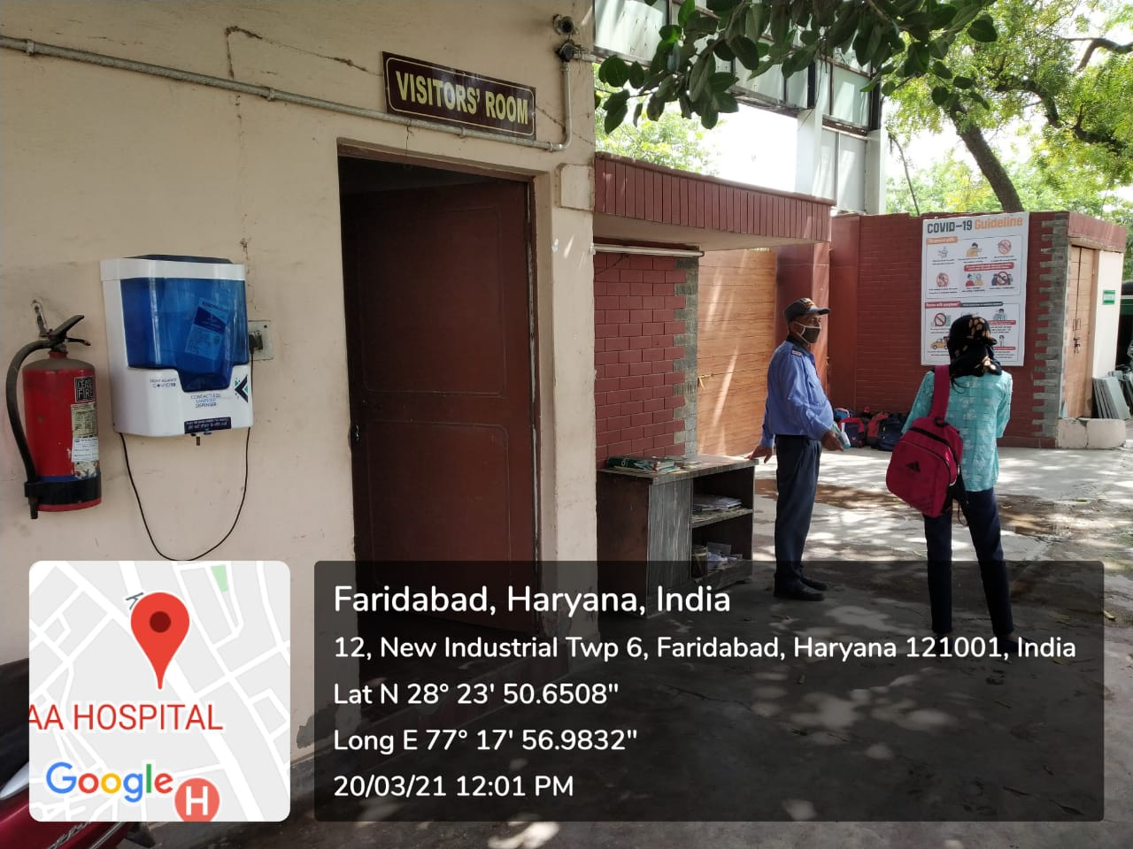
VISITOR’S ROOM NEAR THE COLLEGE GATE
Visitors are not allowed to go beyond the Visitors Room .

Slide 3
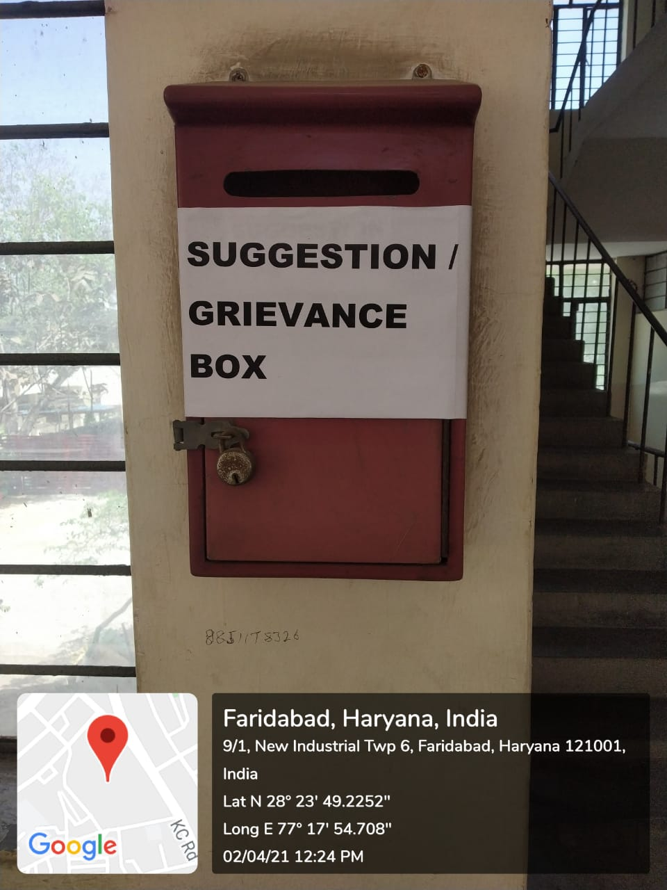
SUGGESTION BOX
Suggestion/Complaint Box where students can drop their grievances . The boxes are opened after every 15 days and their problems are sorted out .

Slide 4
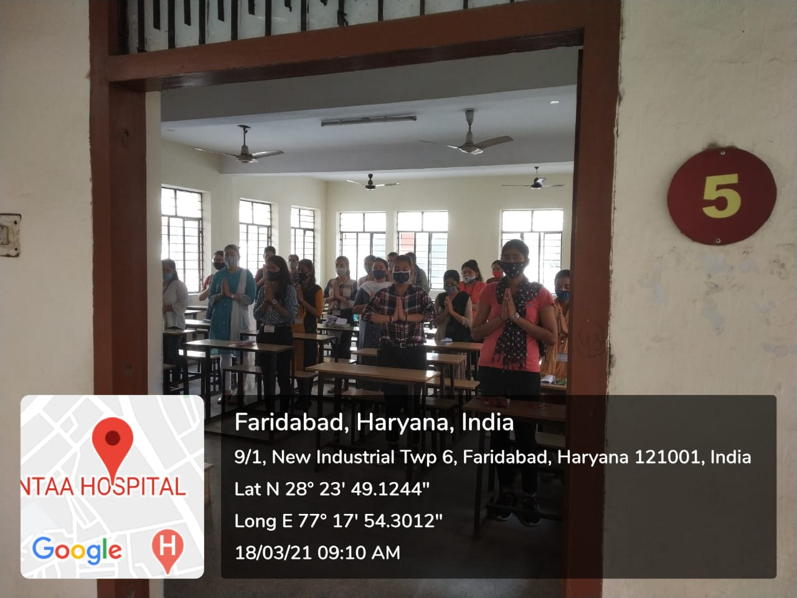
MORNING PRAYER
During morning prayer ,students with folded hands stand up in their respective class rooms .

Slide 5
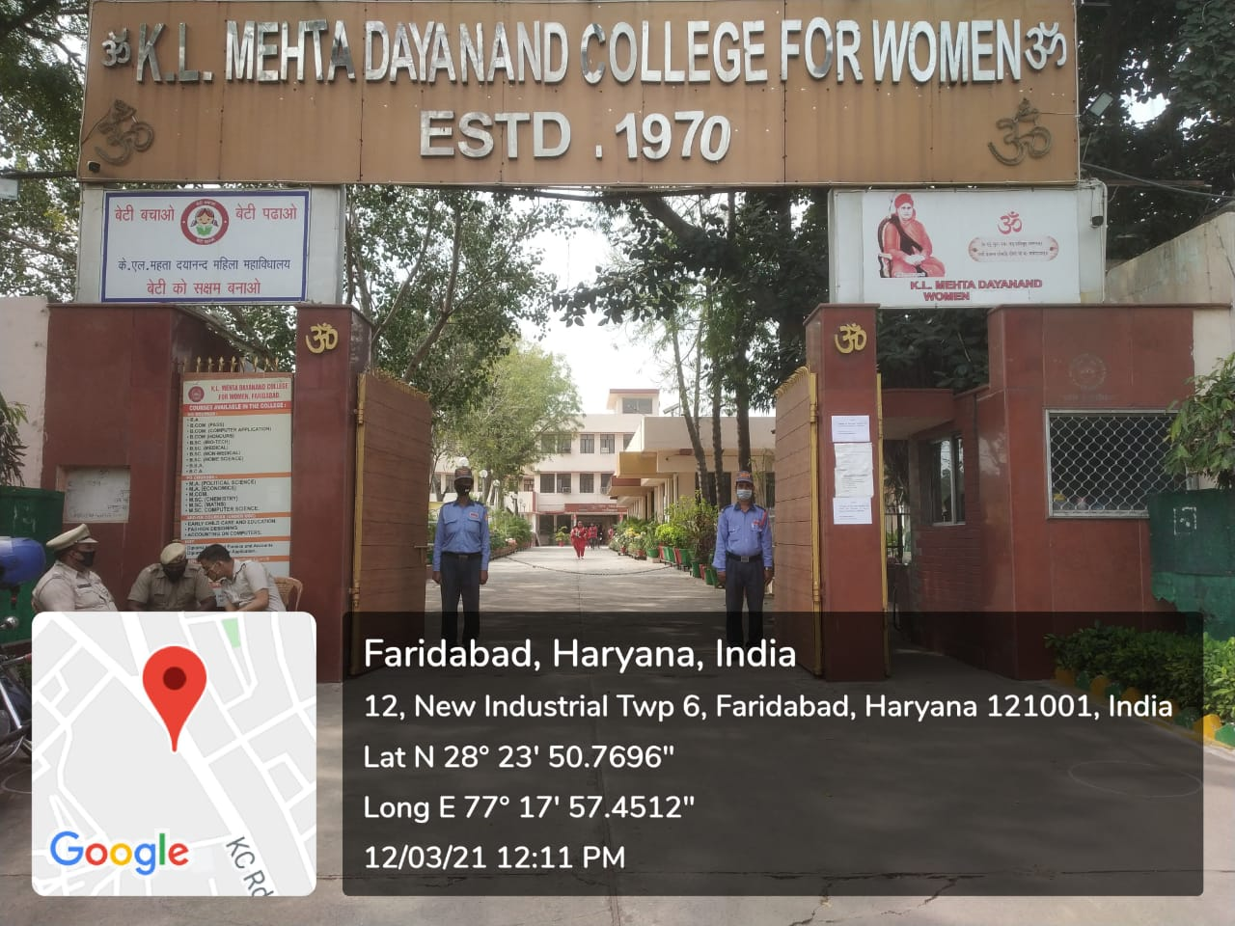
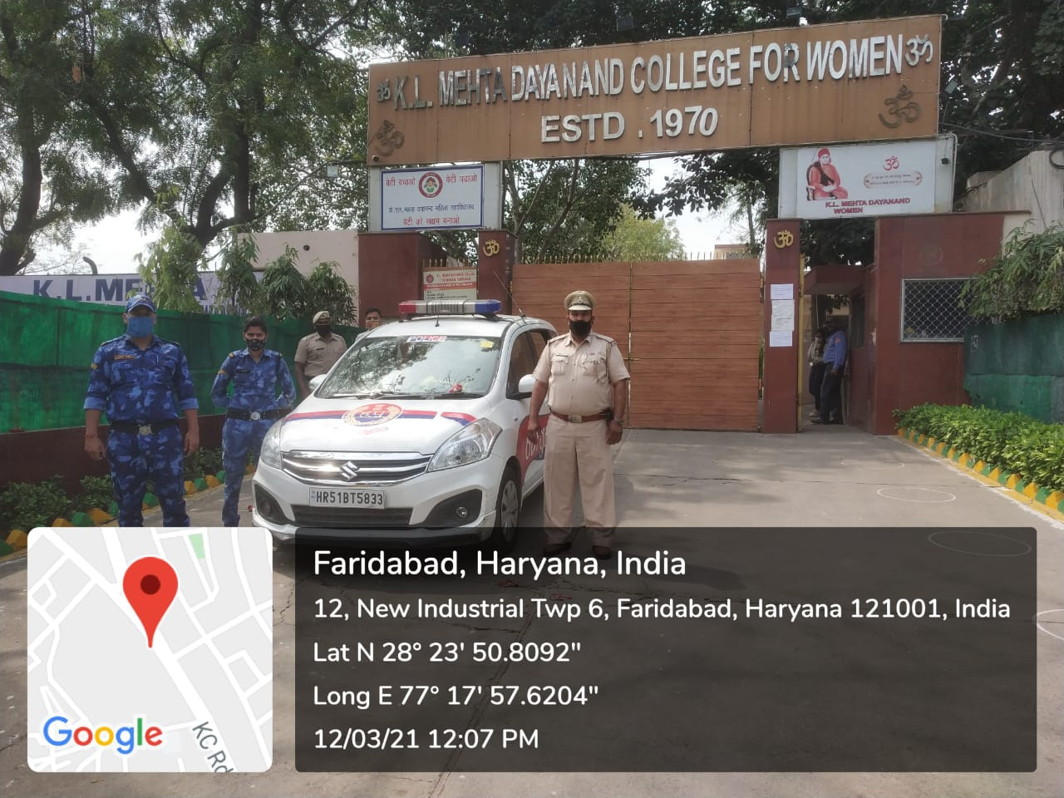
COLLEGE ENTRY/EXIT GATE
Two Security guards maintain vigil at the gate 24*7 .

Slide 6
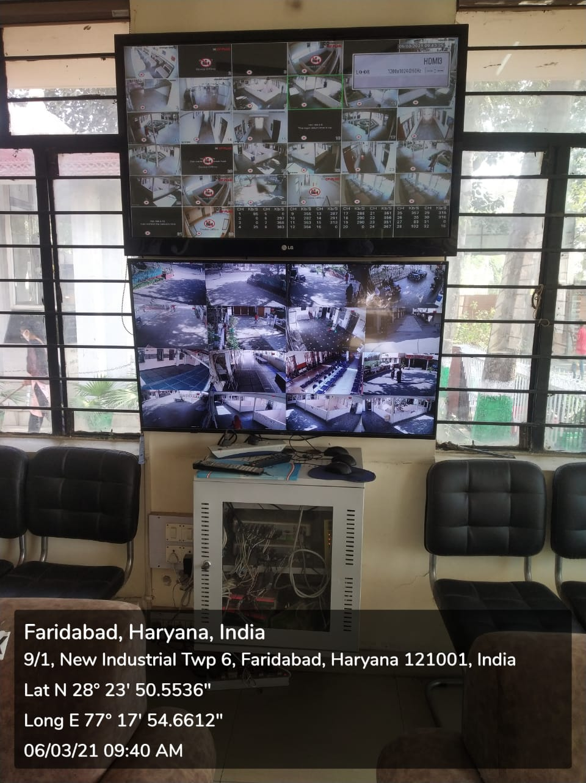
CCTV CAMERAS FOR SAFETY AND SECURITY
College campus is monitored to 64 CCTV cameras including 32 HD cameras .

Slide 7
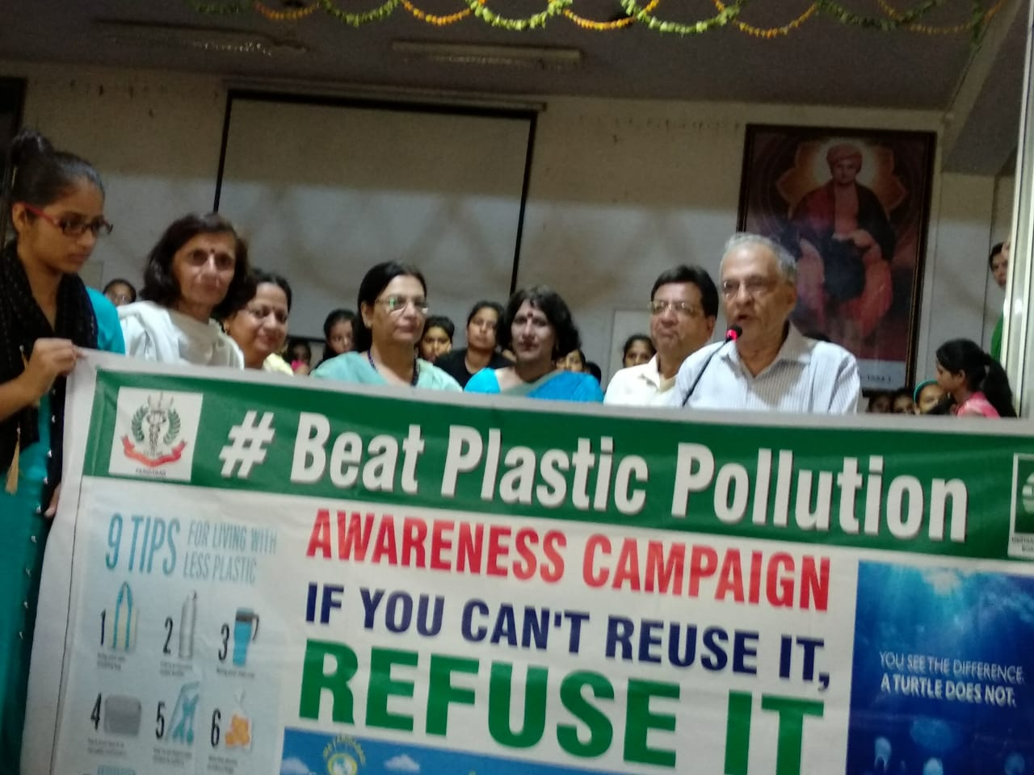
AWARENESS CAMPAIGN TO BEAT PLASTIC POLLUTION
Students are made aware about the problems associated with use of single use plastic

Slide 8
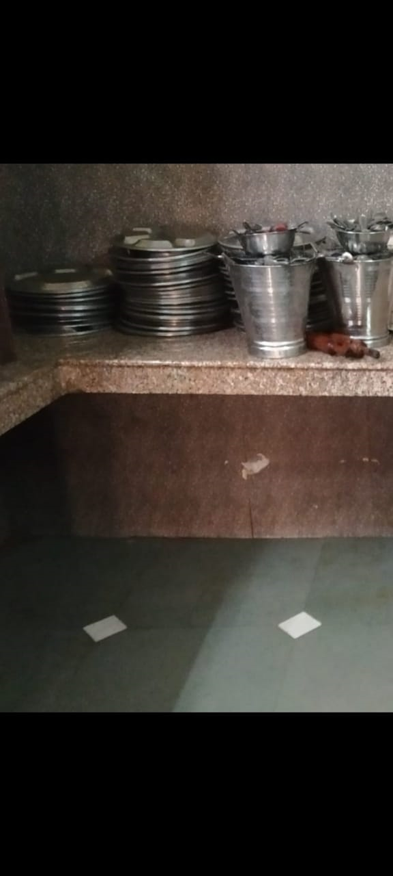
USE OF STEEL UTENSILS IN COLLEGE CANTEEN
College Canteen does not use disposable crockery. Instead of disposable crockery and cutlery, those made of steel are used.

