Slide 1
SUPPORTING DOCUMENT FOR 7.2.1
PART-II
Best practices in the Institutional web site
Any other relevant information

Slide 2
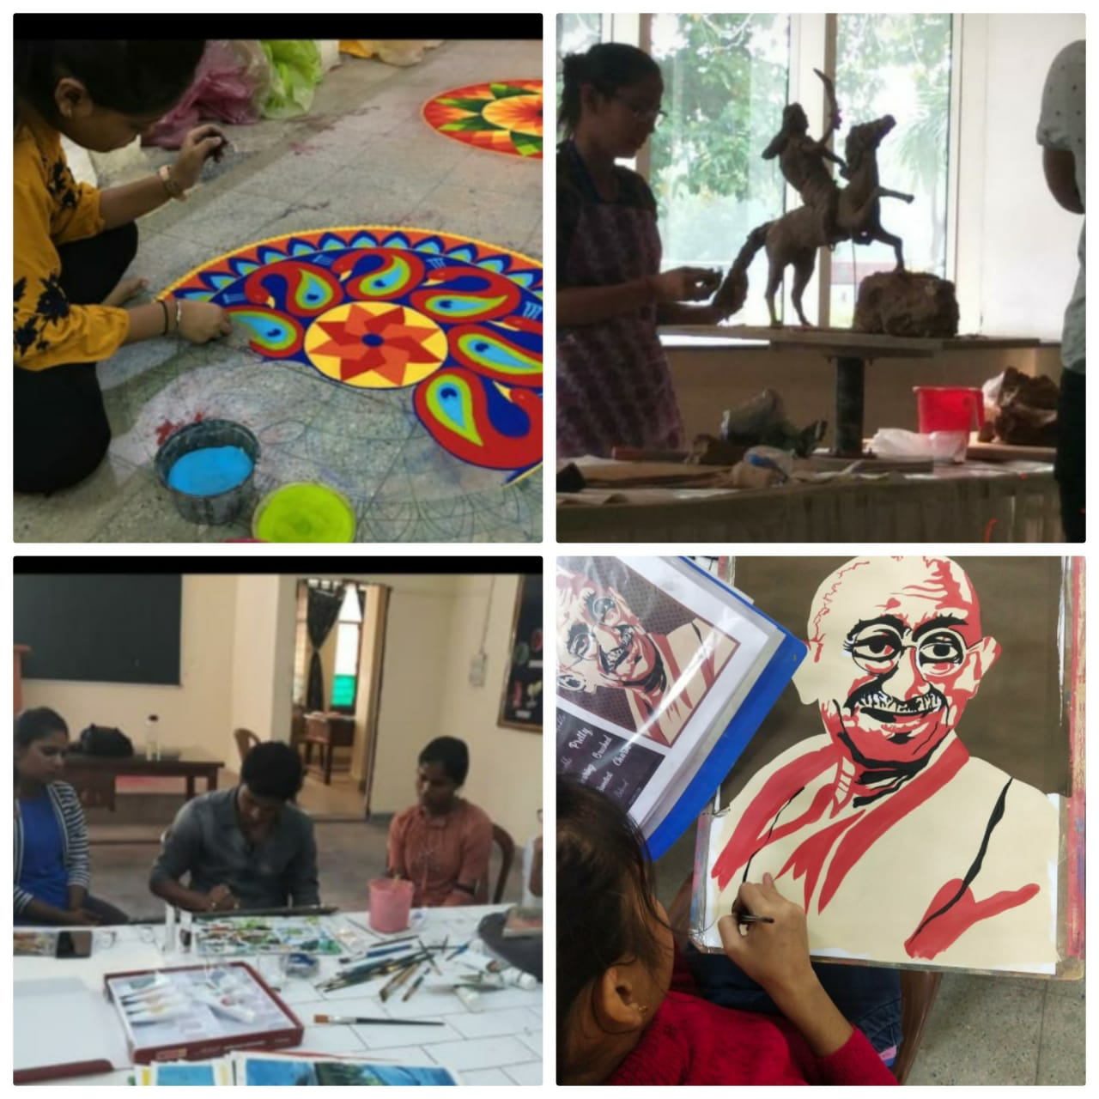
PARTICIPATION IN PERFORMING ART
Student’s potential in performing arts is tapped during Talent Hunt and they are prepared for these activities.

Slide 3
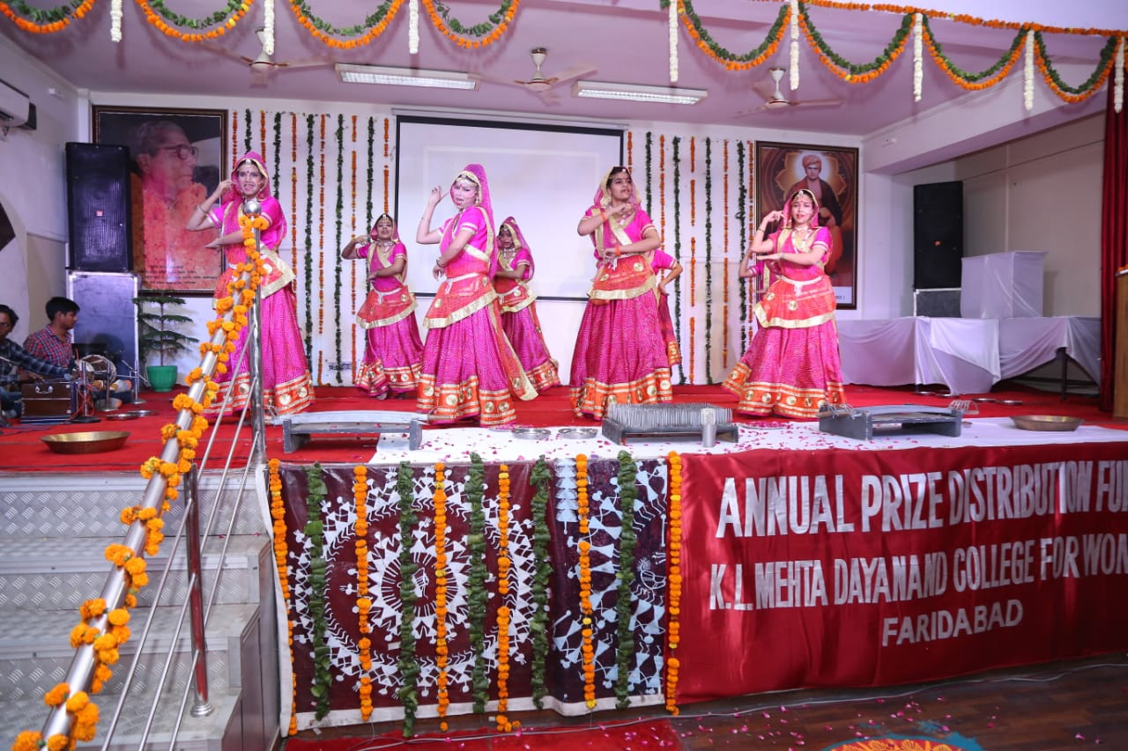
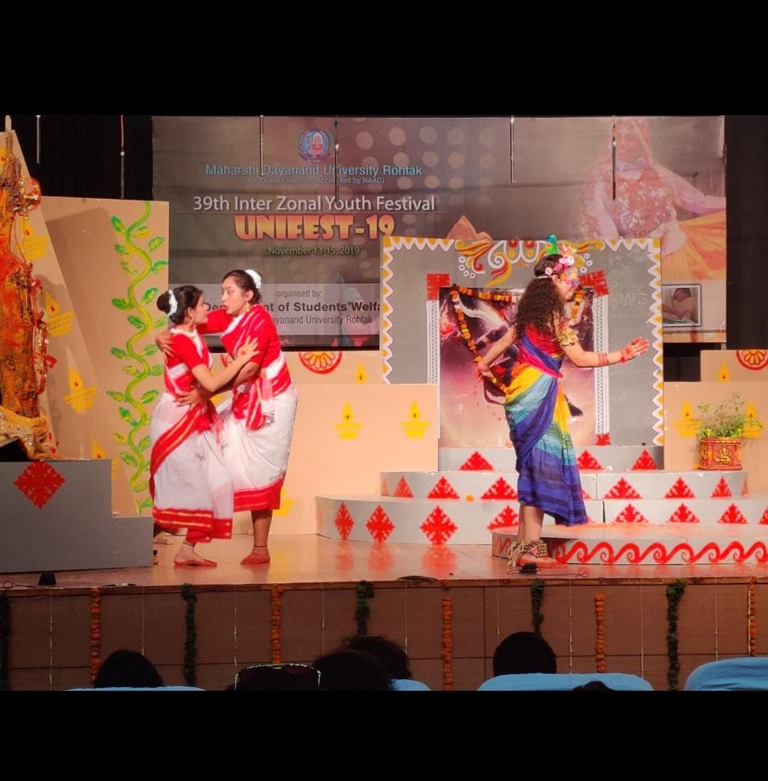
PARTICIPATION IN PERFORMING ART
Student’s potential in performing art is tapped during Talent Hunt and they are prepared for these activities .

Slide 4
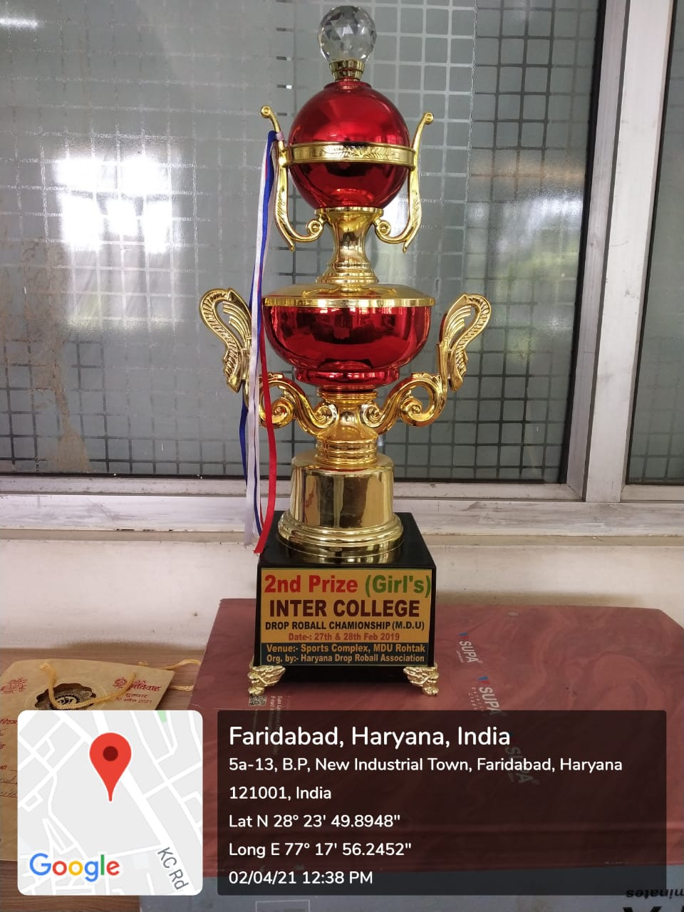
EVIDENCE OF SUCCESS
Students gets trophies and other prizes for their performance in sports

Slide 5
PRIZES WON IN SPORTS
YEAR | NATIONAL /RURAL INTERNATIONAL LEVEL | STATE LEVEL
2015-16 | 4 | 8
2016-17 | 7 | 5
2017-18 | 6 | 2
2018-19 | 8 | 0
2019-20 | 9 | 0

Slide 6
PRIZES WON IN SPORTS

Slide 7
PRIZES WON IN YOUTH FESTIVALS
YEAR | INTER-ZONAL LEVEL | ZONAL LEVEL
2015-16 | 2 | 9
2016-17 | 3 | 12
2017-18 | 6 | 17
2018-19 | 6 | 10
2019-20 | 11 | 22

Slide 8
PRIZES WON IN SPORTS

Slide 9
EVIDENCE OF SUCCESS
Students gets trophies and other prizes for their performance in sports .

Slide 10
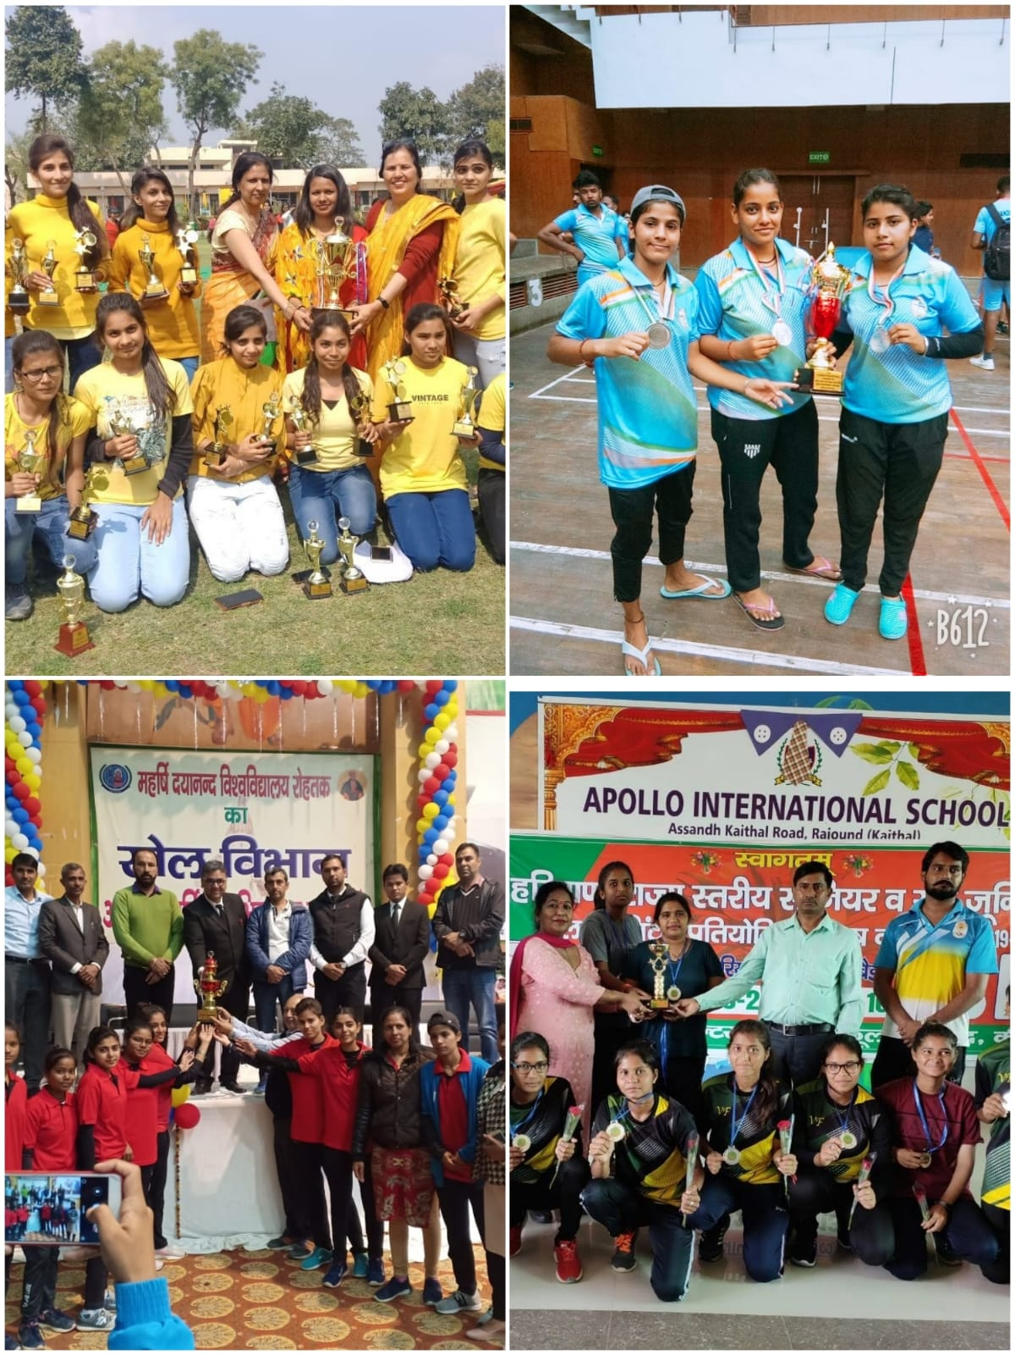
EVIDENCE OF SUCCESS
Prizes and appreciations are great motivators for these students

Slide 11
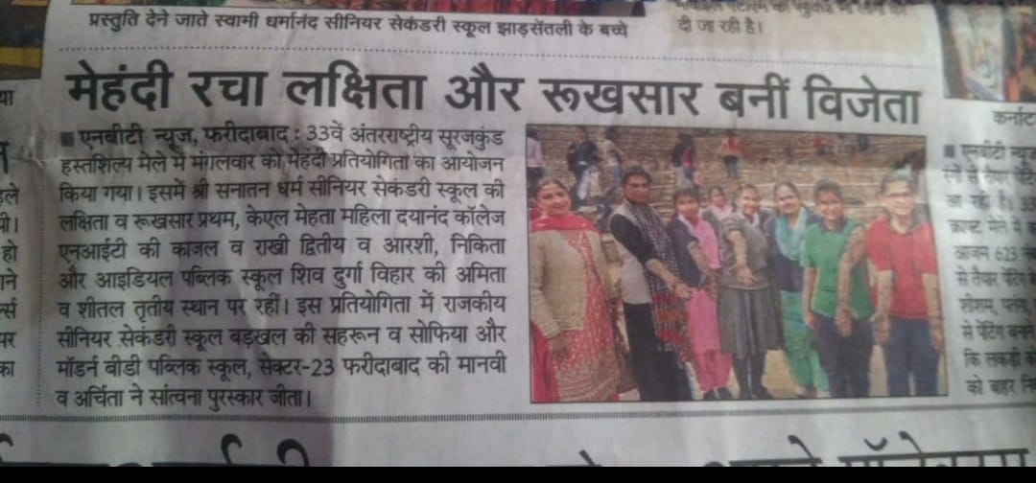
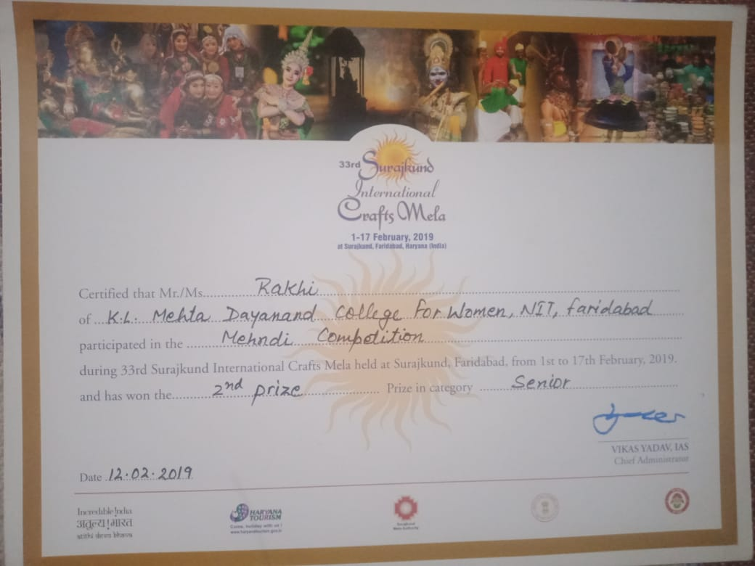
RESULTS OF MEHNDI COMPETITION
Students participating in various competitions like; Mehndi , Rangoli etc. win prizes at the Inter College Competitions
.

