Slide 1
SUPPORTING DOCUMENT FOR 7.2.1
PART - I
Best practices in the Institutional web site
Any other relevant information

Slide 2
This document includes information regarding:
1. Solar Energy
2. Rain Water Harvesting
3. Waste Water Recycling
4. Restricted entry of automobiles
5. Pedestrian-friendly pathways

Slide 3
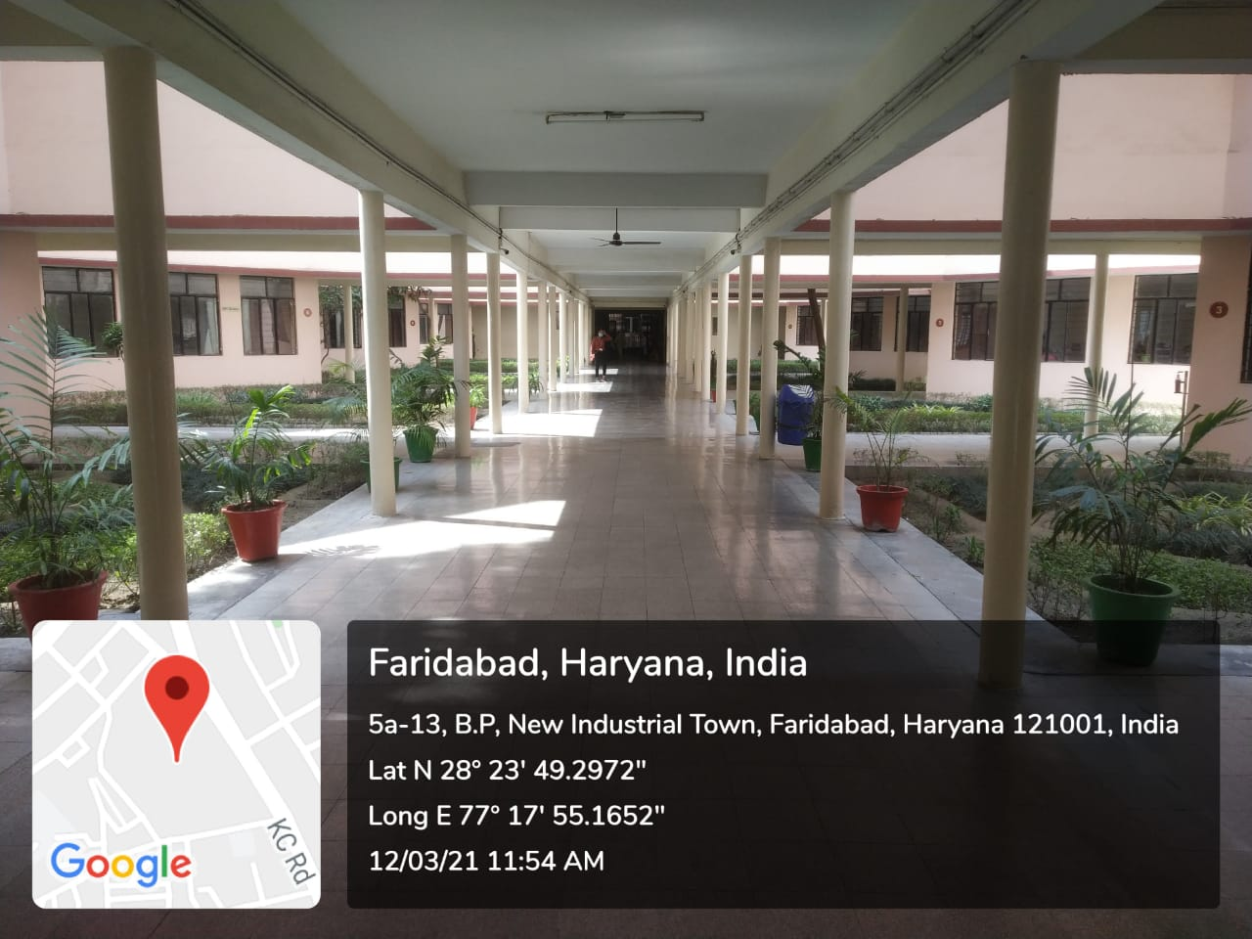
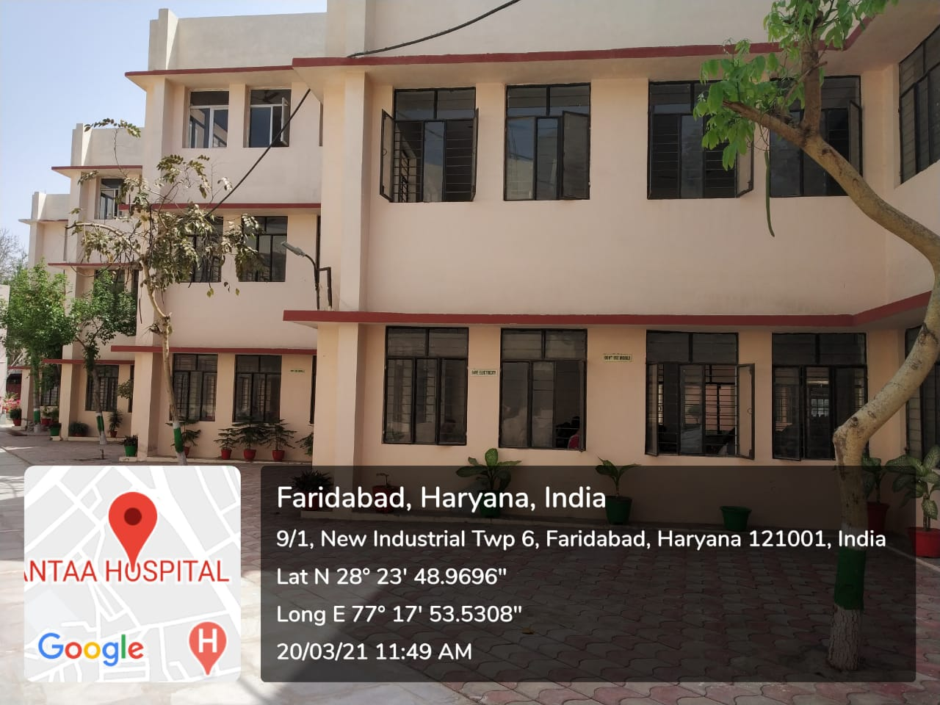
WELL LIGHTED AND VENTILATED ROOMS
College buildings are designed in such a way that most of the rooms have windows on three sides. This architecture helps in the maximum use of natural light. Artificial light is required only during foggy or cloudy days

Slide 4
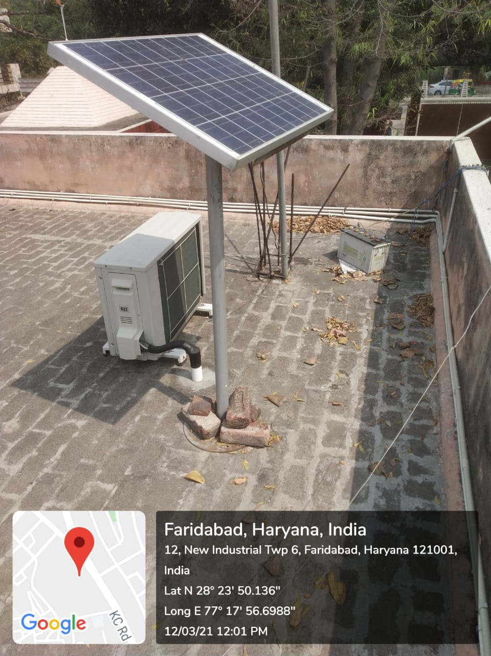
SOLAR PANEL
A solar panel is installed, which is used for lighting the driveway

Slide 5
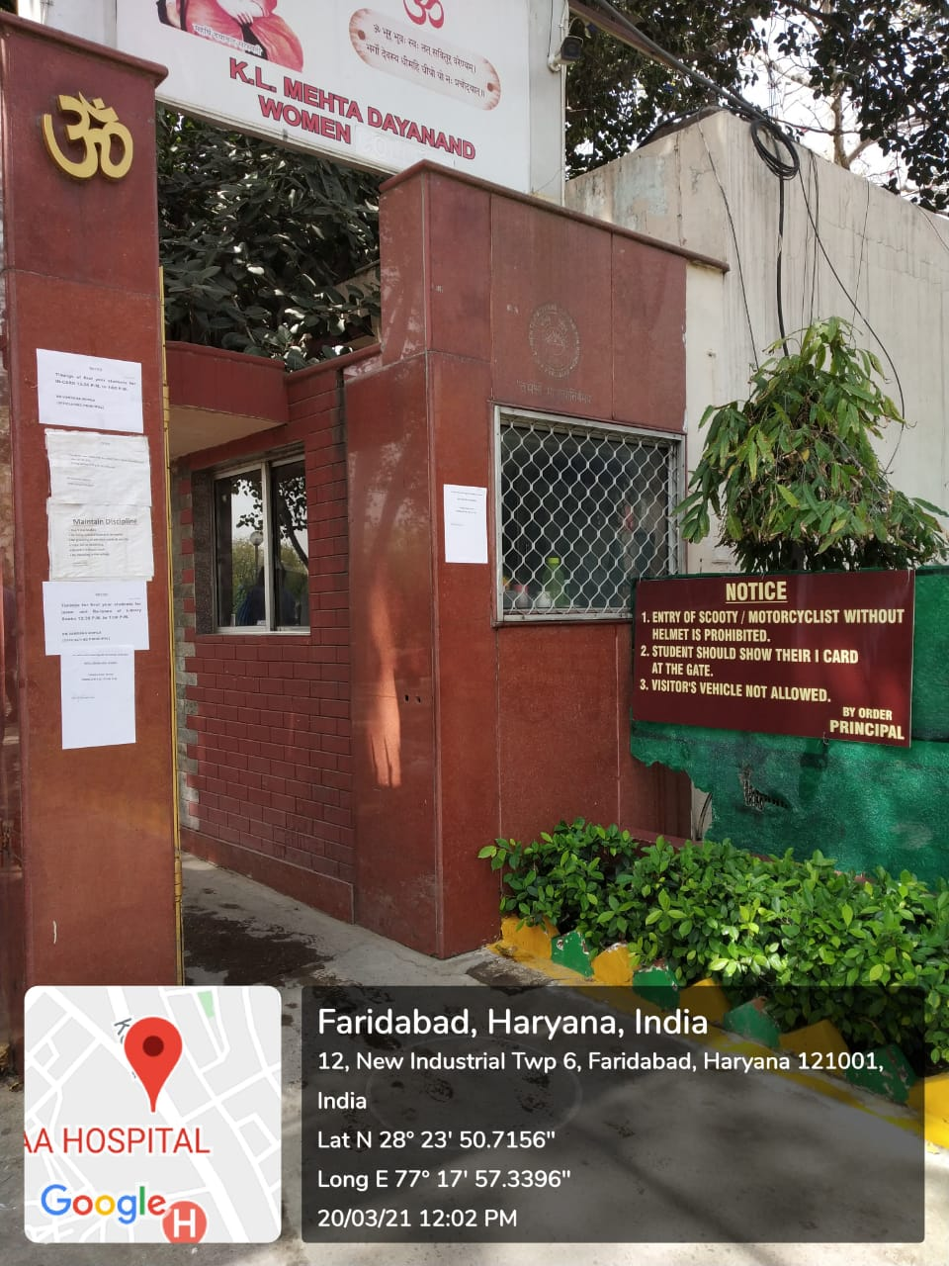
ENTRY AND EXIT GATE OF COLLEGE
Parking is near the entry/exit gate. No vehicle of outsiders is allowed to come inside. Students and staff members are motivated to use public transport.

Slide 6
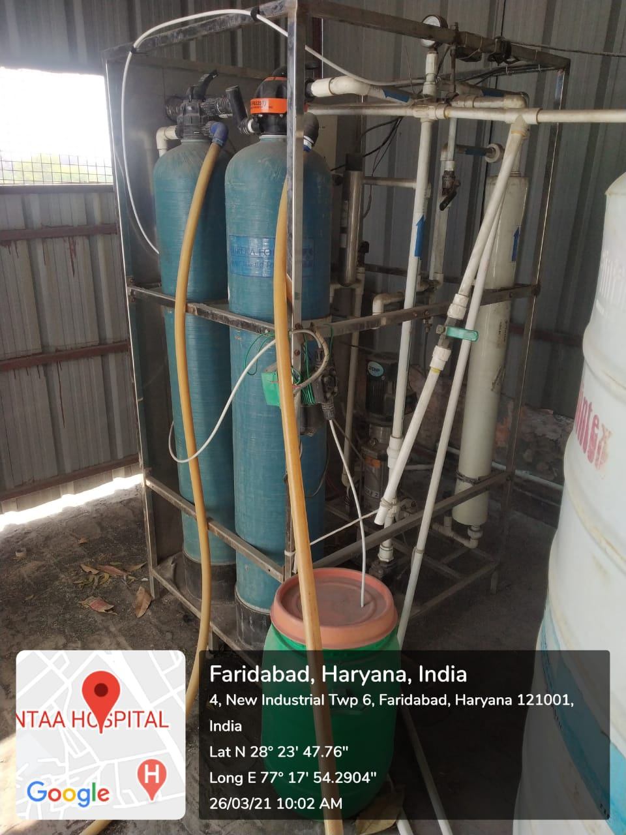
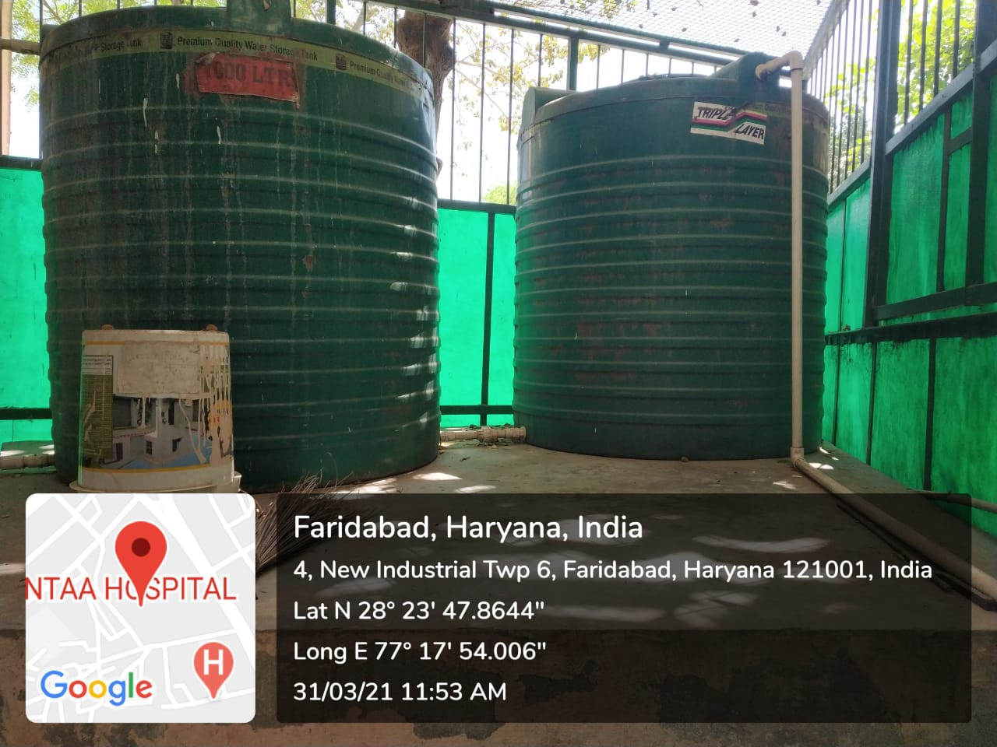
RO PLANT FOR SAFE DRINKING WATER
Waste water from RO Plant is collected in two 1000 litres tanks and is used in the washrooms and for cleaning purposes

Slide 7
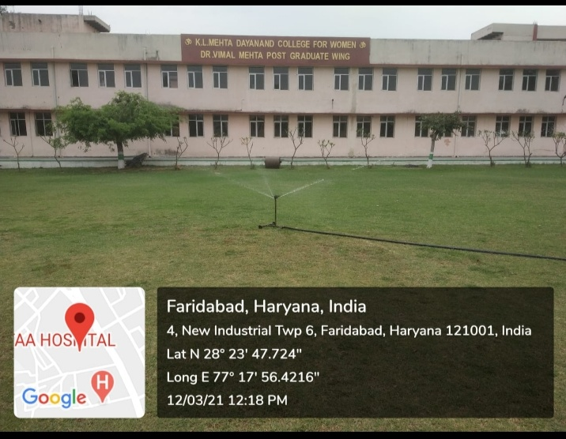
WATER SPRINKLER
Sports ground is irrigated with a sprinkler system so that least amount of water is wasted by evaporation .

Slide 8
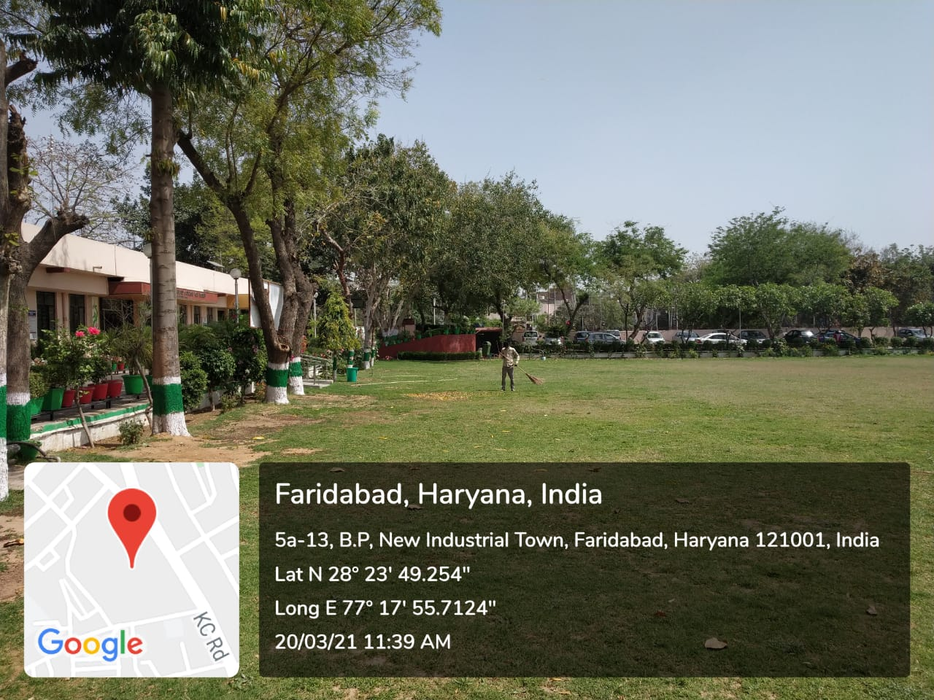
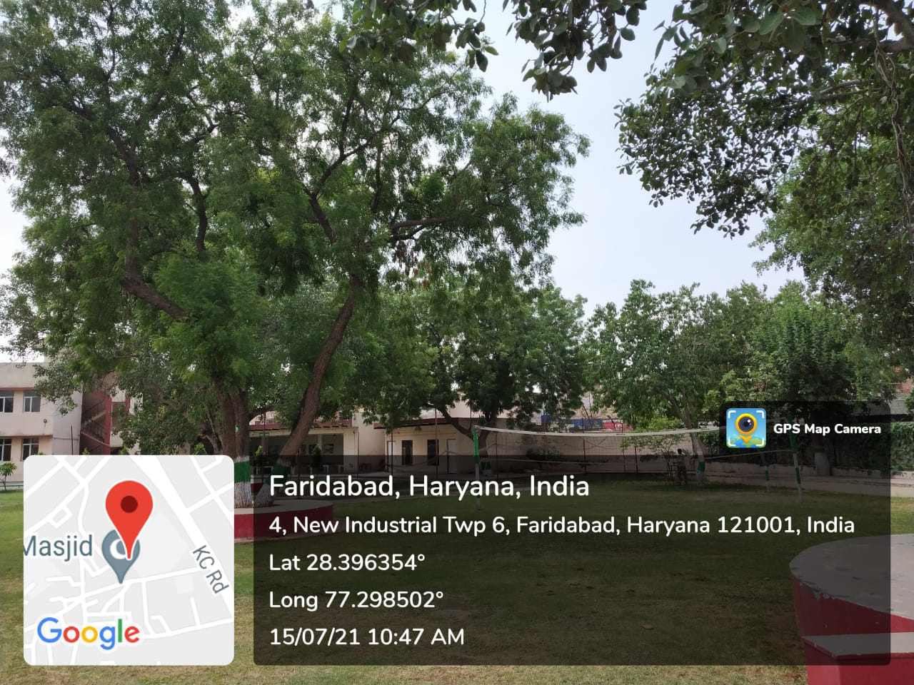
GREENERY AROUND THE CAMPUS
Lush green ground and trees in the college add greenery around the campus .

Slide 9
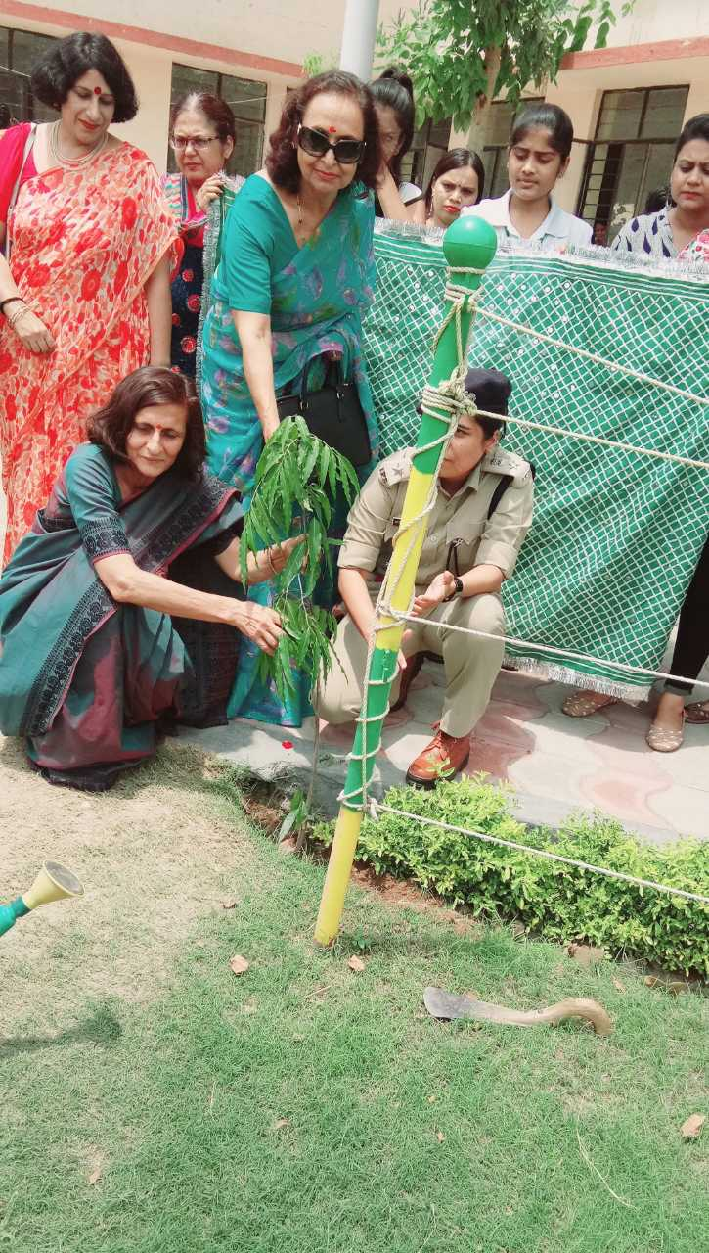
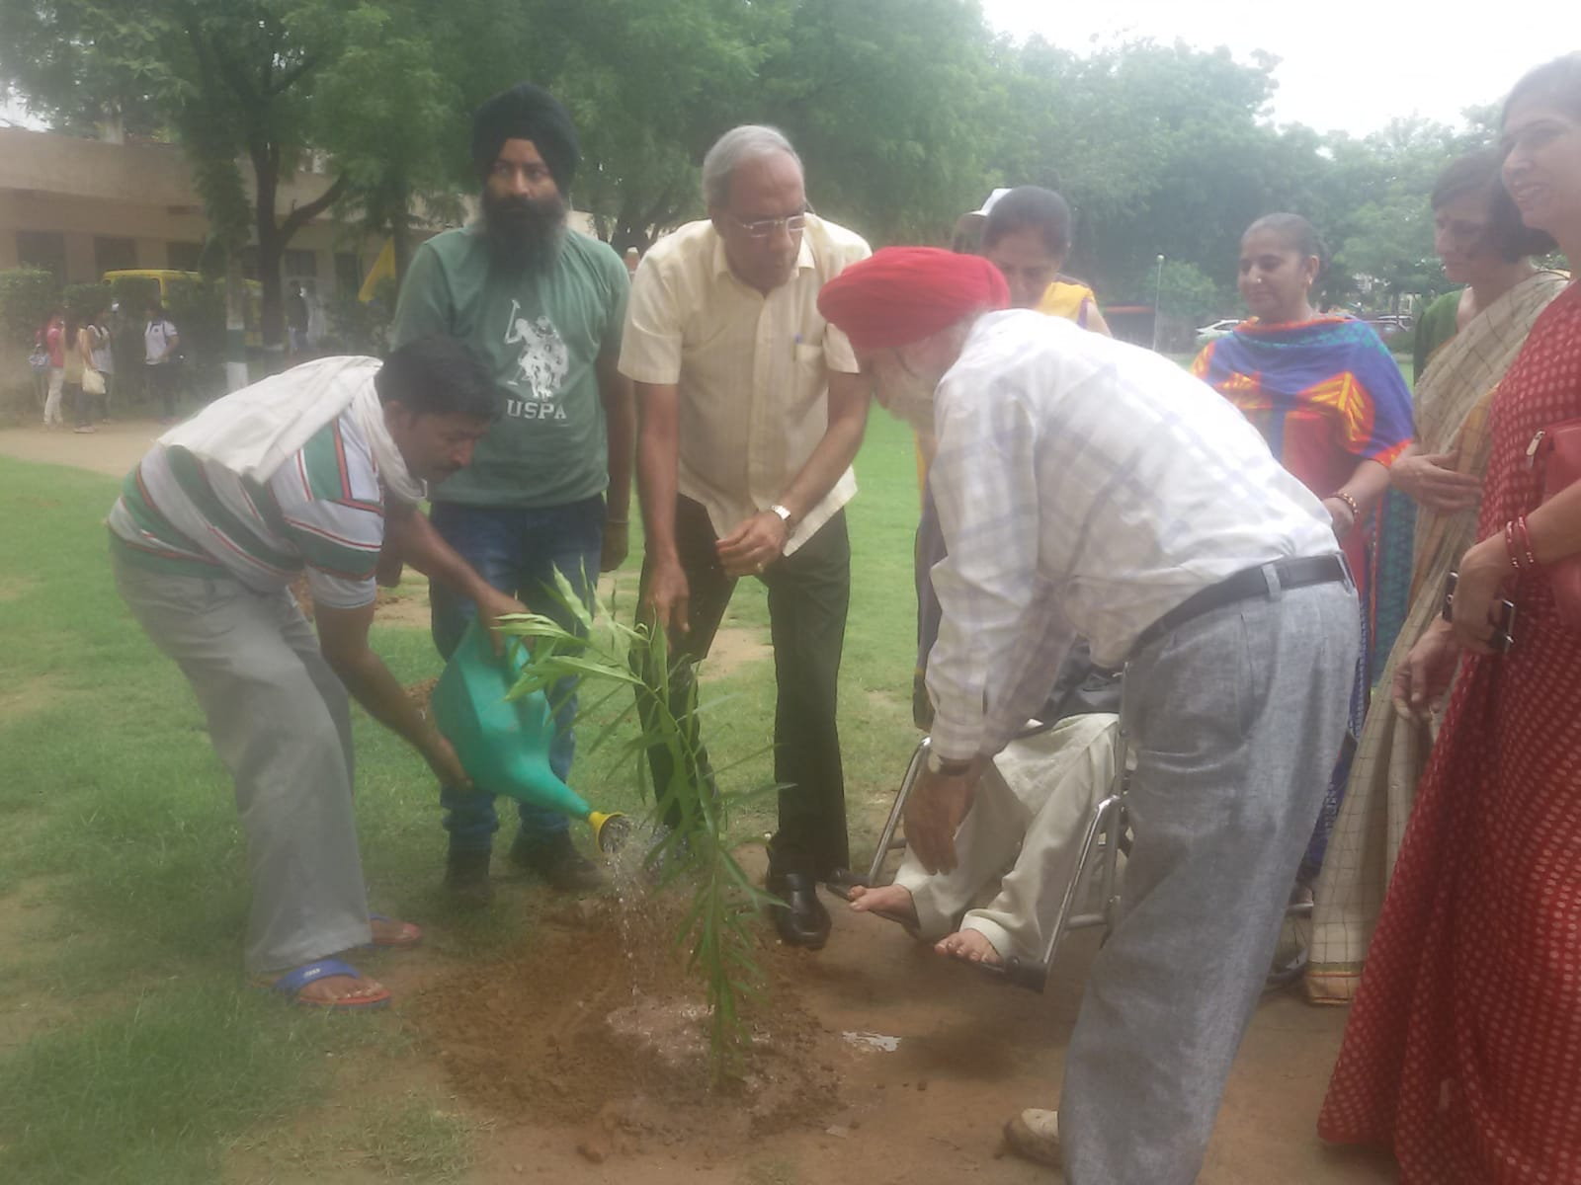
TREE PLANTATION IN THE CAMPUS
Tree Plantation is done every year and students are encouraged to take care of the plants .

Slide 10
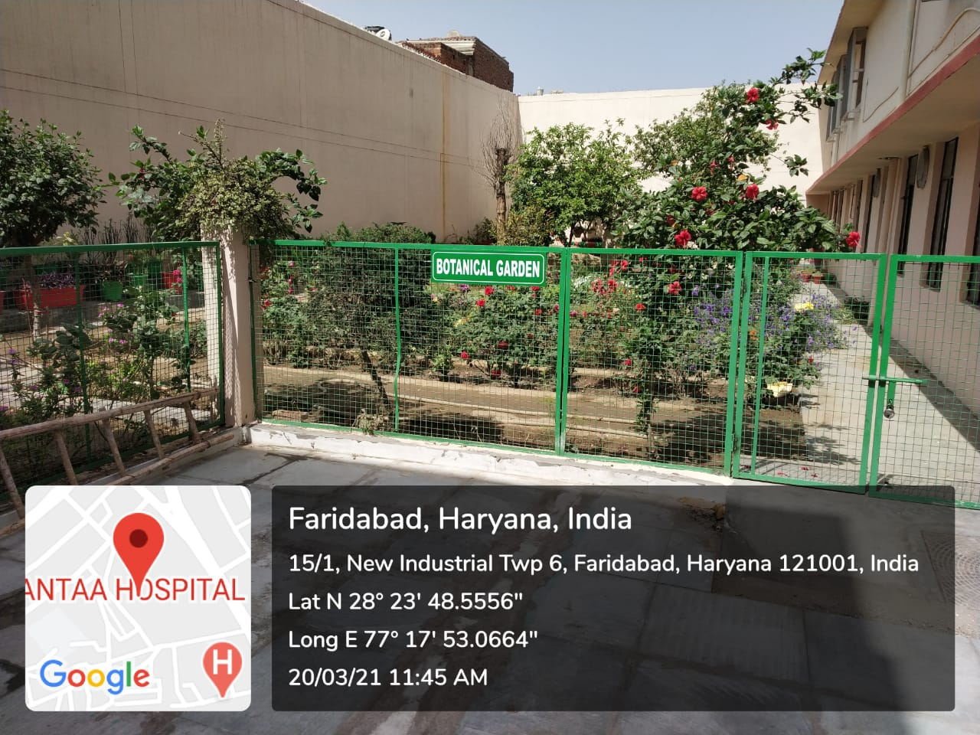
BOTANICAL GARDEN
Small Nursery with various species of plants is maintained in the Botanical garden .

Slide 11
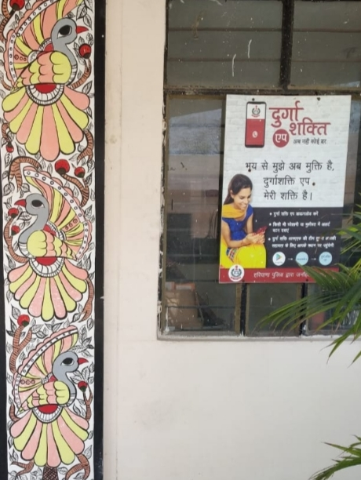
DURGA SHAKTI APP
Students are encouraged to download “Durga Shakti App” to seek immediate help of the police when in distress .

Slide 12
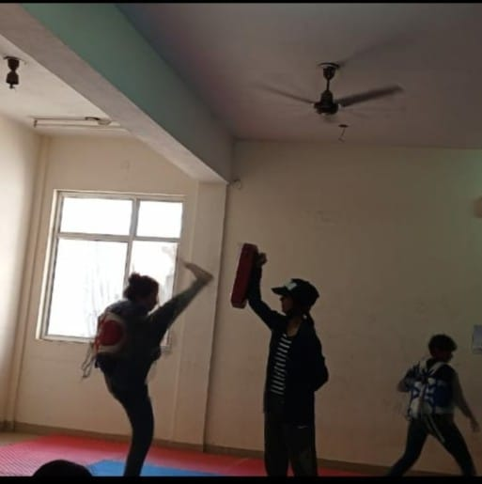
SELF DEFENSE TRAINING
Taekwondo class is organized for self-defense .

Slide 13
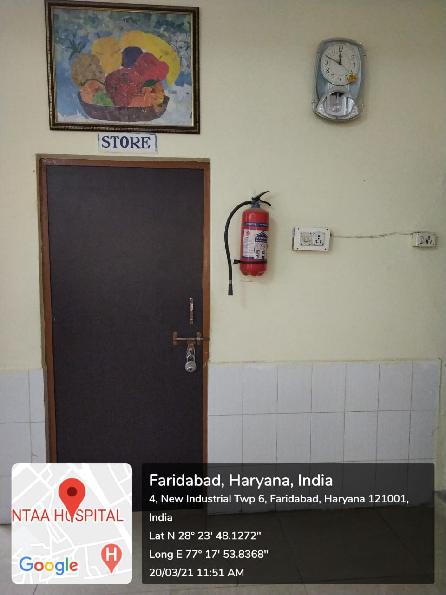
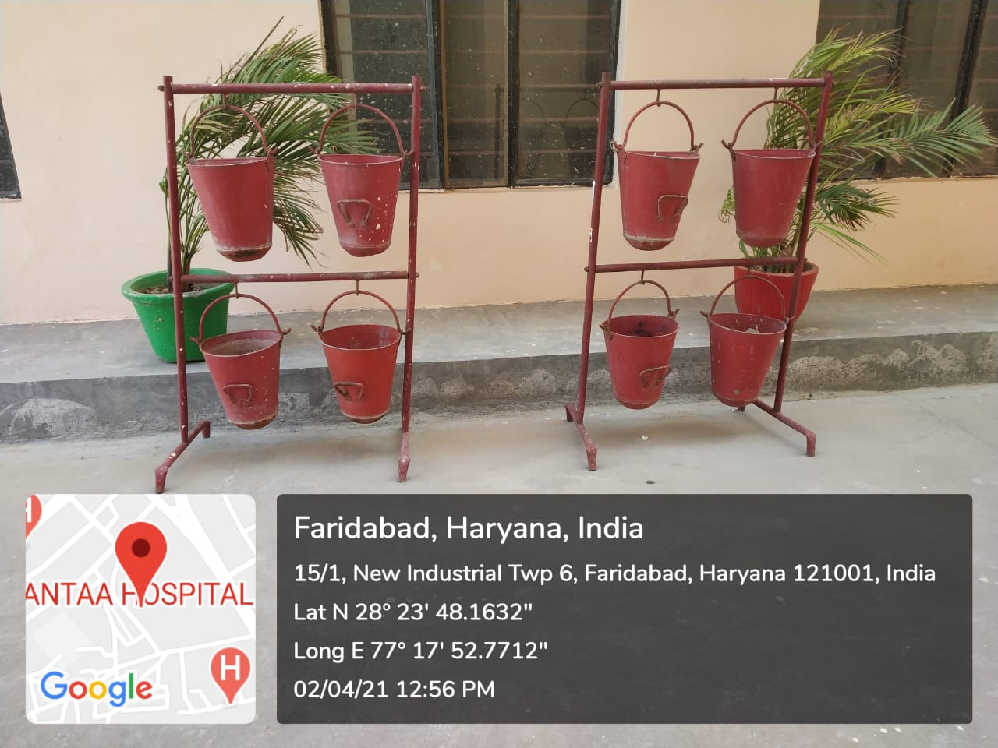
FIRE EXITINGUISHER IN LABORATORY
Fire extinguisher in Laboratory is installed for protection against fire during emergency situation

Slide 14
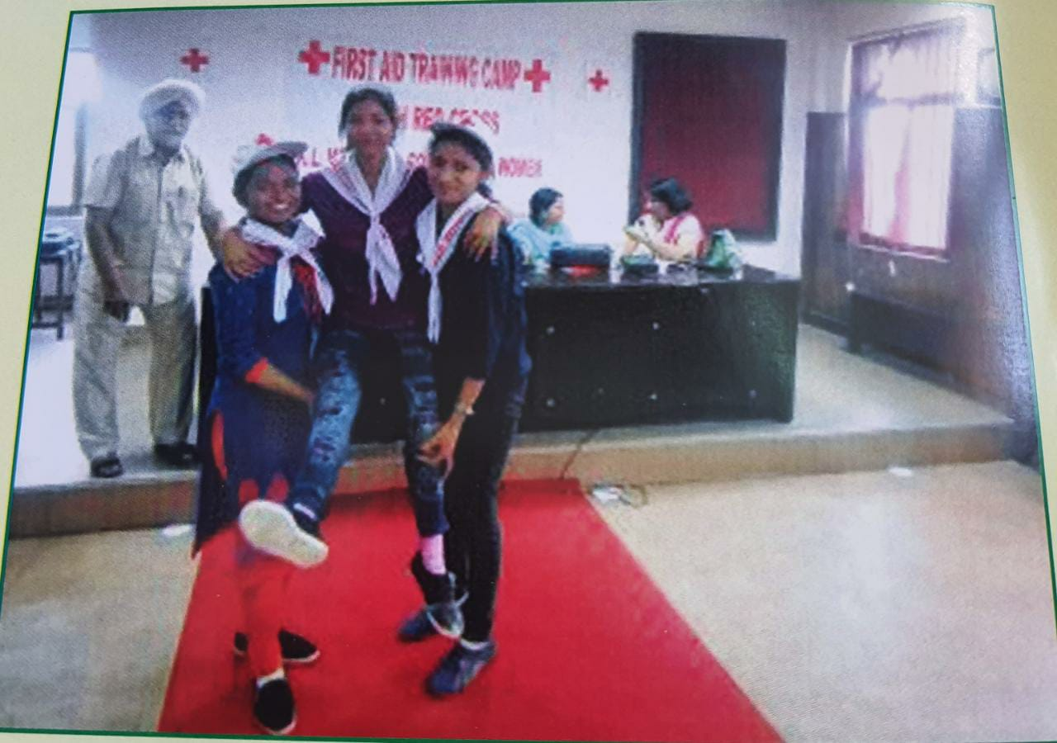
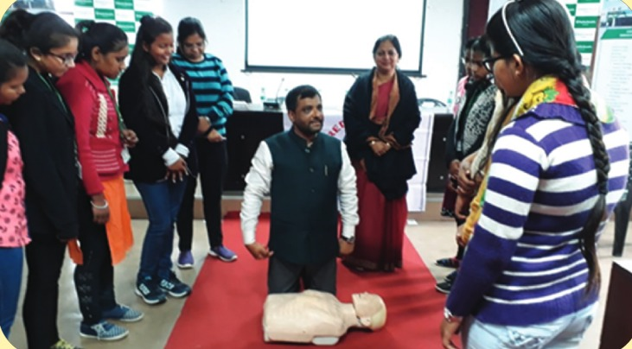
FIRST AID TRAINING CAMP
Training related to First Aid is given to the student for immediate assistance to any person suffering from minor injury/illness .

