Slide 1
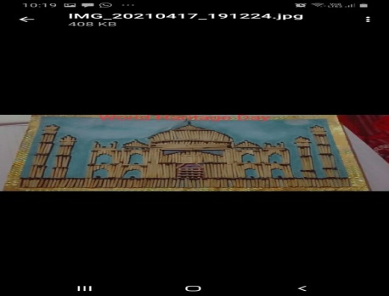
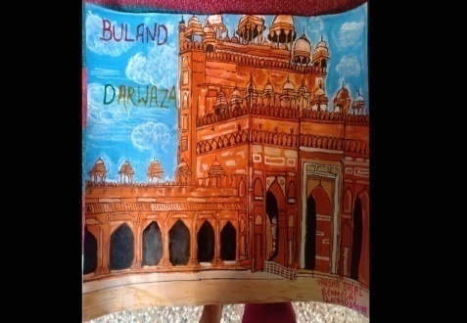
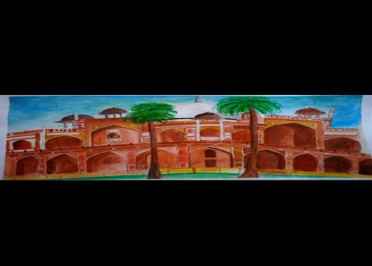
K.L MEHTA DAYANAND COLLEGE FOR WOMEN
DEPARTMENT OF HISTORY
18 APRIL
CELEBRATES
WORLD HERITAGE DAY
2
3
CONTEST WINNER
1
MANISHA YADAV
Bcom C.A(I YEAR)
120179039057
VARSHA
Bcom.(C.A) I Year
120179039049
ALKA CHAUHAN
Bsc.HOME SCIENCE(2year)
3164920008

